Slide 1

Mangalore UNIVERSITY
A project Report On
“ONLINE FEEDBACK SYSTEM FOR MANAGALORE UNIVERSITY IN KANNADA”
Presented By
Pratibha Bharathi S D
Reg.No: 201021387124
Under the Guidance
Dr. H.L. Shashirekha
Chairperson Department of Computer science
Department of Post-Graduate Studies and Research in Computer Science
Mangalore University,
Mangalagangotri-574 199
December 2022

Slide 2
Outline
INTRODUCTION
OVERVIEW
PROBLEM STATEMENT
MOTIVATION
ADVATAGES
EXISTING SYSTEM
FRAMEWORK
SYSTEM DESIGN
USER LOGIN
ADMIN LOGIN
ER DIAGRAM
DATABASE
RESULTS
CONCLUSION AND FUTURE WORK
REFERENCES

Slide 3
OVERVIEW
The Online student feedback system is the web-based feedback collecting system from the students and provides the automatic generation of a feedback which is given by students.
We have developed student feedback system to provide feedback in a quick and easy manner to the particular faculty’s and to the particular course.
NAAC and Higher Education inspects the infrastructure, facilities and also assesses the performance and academic excellence of the teachers and course of an institution. It gives grades on the basis of performance and prospects of an institution.
This type of Online Student Feedback system reduces, the strenuous work of physically examining the feedback pages of each and every student.
This Project has two kinds of modules Student and Admin.

Slide 4
Continued…
Students can login into their accounts and give feedback for the selected teacher, course and college.
Admin can add/remove teachers, departments, course, paper and students according to the requirement.
Admin can able to analysis the feedback.
In this project Security also maintained, feedback is only visible to authenticated user. Only Admin can check the feedbacks.

Slide 5
PROBLEM STATEMENT
The purpose of this online feedback system questionnaire is to gather information on students learning experience, as well as students response.
When clicking the answer, we have to think of these questions as your subjective perceptions on various aspects of the course and the teacher's involved in the program.
A typical feedback form consists some questions where students have to give a grade.
One student is allowed to give only one time feedback in one turn.

Slide 6
MOTIVATION
It enables the learner to reflect on their learning strategies to confirm them or make changes to improve their learning.
The success of any teaching programme lies in planning a curriculum, which allows the students to gain maximum meaningful knowledge in the short span of time available.
The student feedback is generally obtained as answers to a set of questions, which are designed to cover all aspects of course delivery to students.
The students undoubtedly are in the best judges to assess the teaching and evaluation methods

Slide 7
ADVANTAGES
The proposed system purpose is to take feedback from students in online regarding the lecturer’s, course and college teaching.
Student can submit feedback in efficient manner without any loss of data.
The admin can access these feedbacks from the students and easy to analysis the feedback.
• Student can give feedback in online.

Slide 8
EXISTING SYSTEM
In existing system the feedback is done only for the second, fourth, and sixth semester students.
The existing system students can give feedback about the lecturers, course and overall opinion about Mangalore University.
There were few flaws in old software like students were struggling to select the proper course and faculty name while giving feedback.
To overcome that problem, we came up with new improved software where both odd and even semester students can give the feedback.

Slide 9
CodeIgniter
CodeIgniter is a PHP MVC framework used for developing web applications rapidly.
It is an Open Source framework.
It has a very rich set of functionality, which will increase the speed of website development work.
MVC stands for Model View Controller. When a user requests a resource, the controller responds first. The controller understands the user request then request the necessary data if necessary.

Slide 10
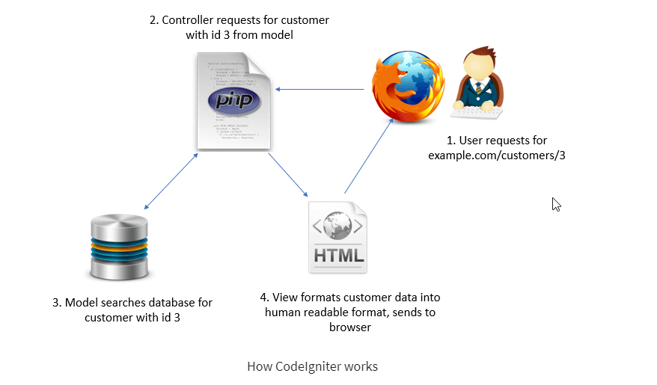
The following image shows how CodeIgniter works:

Slide 11
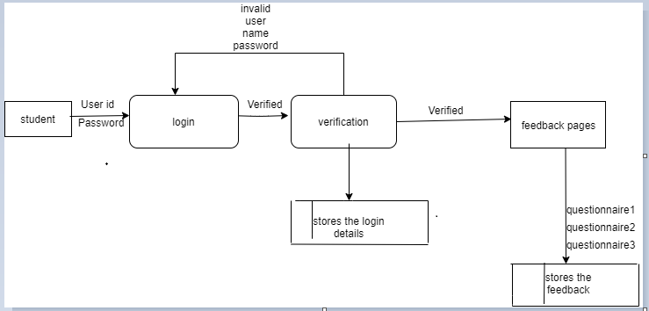
SYSTEM DESIGN user login

Slide 12
User login
In this module user login the account through the valid login string which is provided by the admin and they have to choose the language ,after login the student can give the feedback to faculty .
The given feedback will be stored in the database and the admin can take decision on that result.
The one login string will be valid for given feedback once.

Slide 13
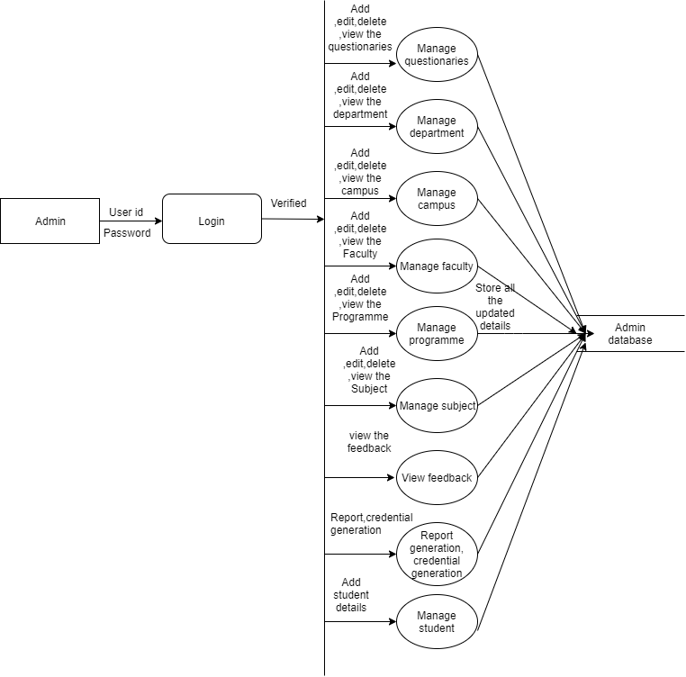
Admin Login

Slide 14
In this module the admin have the authority to manage the whole project.
Administrator can handle the front end and back end of the website as well.
Admin will generate the login string to give the feedback.
Admin will manage and add course, programme, campus, faculty etc
Admin will generate the report and analyse the given feedback.

Slide 15
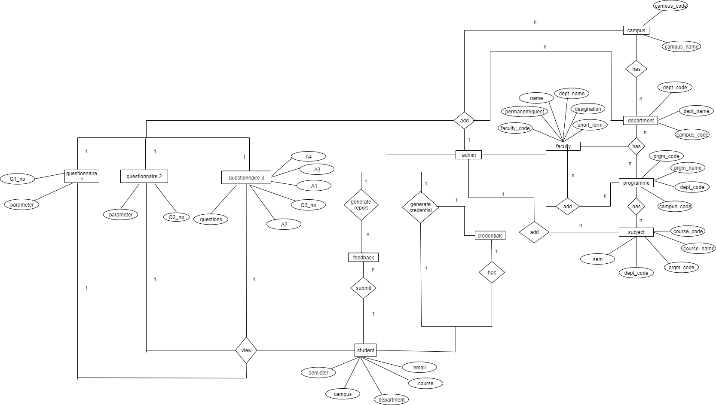
ER Diagram

Slide 16
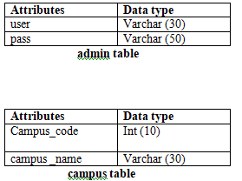
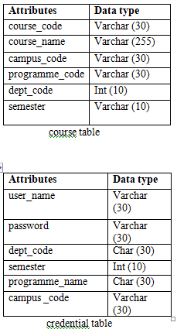
DATABASE:

Slide 17
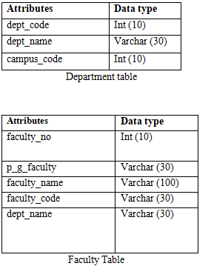
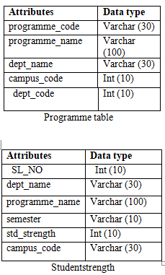
Continued..

Slide 18
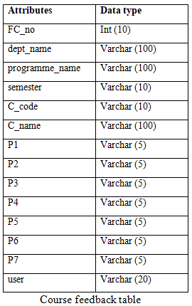
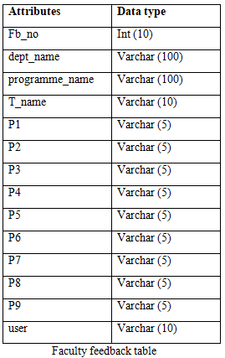
Continued..

Slide 19
User Interface

Slide 20
User(student) will login with use of User id and Password.
If the user name and password is incorrect relevant message will be displayed.
The user have to choose the language either Kannada or English.

Slide 21
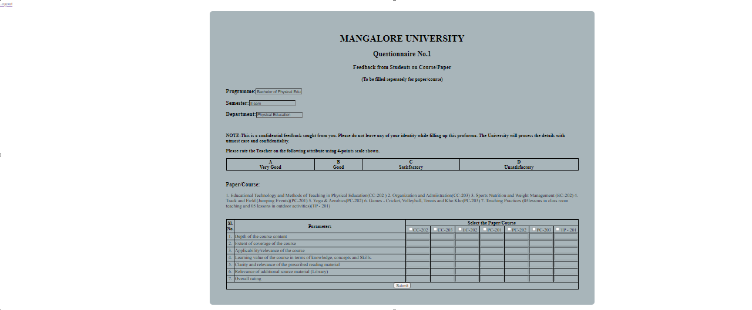
Questionaire1

Slide 22
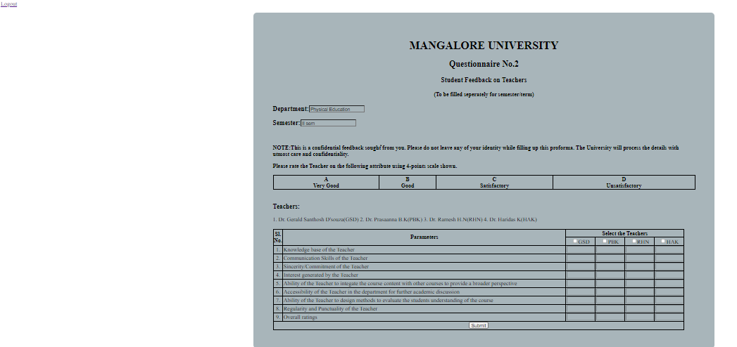
Questionaire2

Slide 23
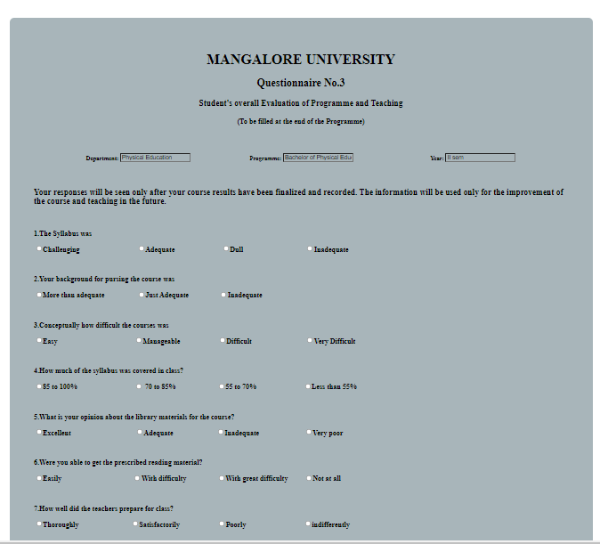
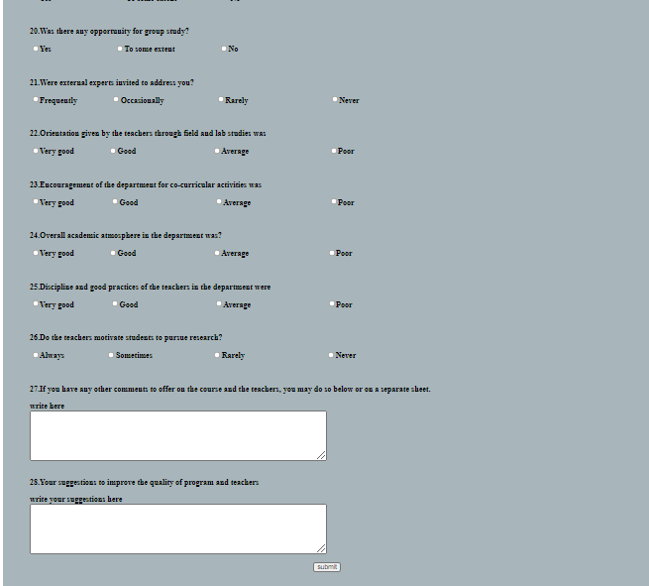
Questionaire3

Slide 24
There are four questionaries like course ,permanent faculty ,guest faculty and college .
Based on the students user id Department, programme and semester is displayed in questionaries form.
And also course and Faculty list is displayed based on their campus, department, programme and semester.

Slide 25
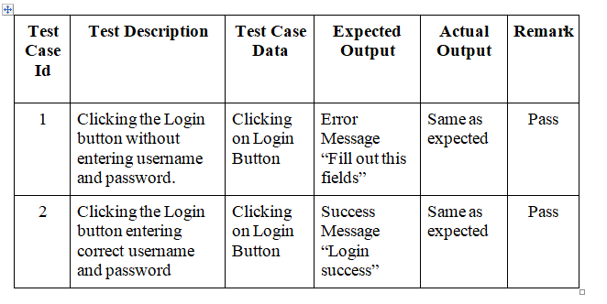
Test Case for User Login

Slide 26
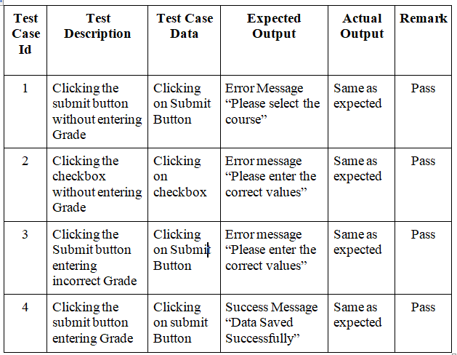
Test Case for Questionnaire 1:

Slide 27
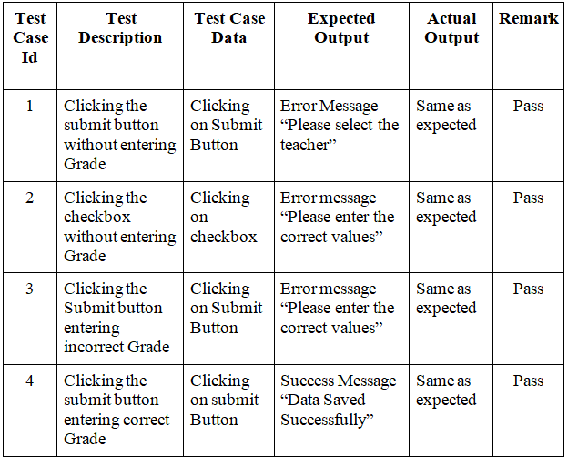
Test Case for Questionnaire 2:

Slide 28
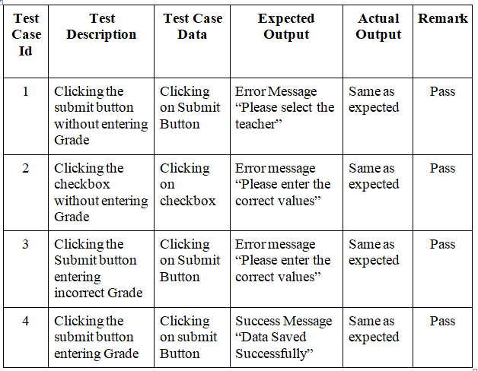
Test Case for Questionnaire 2a:

Slide 29
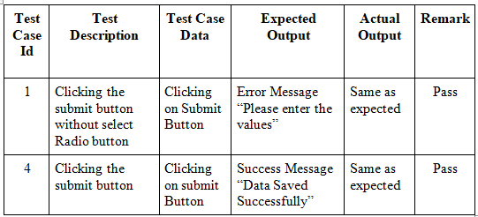
Test Case for Questionnaire 3:

Slide 30
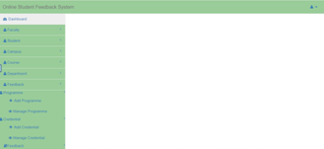
Admin Dashboard
This is the Admin dashboard contains modules like faculty, student, campus, course, department and programme.
Admin has logout option.

Slide 31
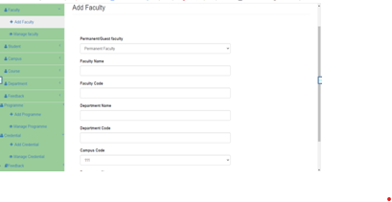
Using this form admin can add new records to the database.

Slide 32
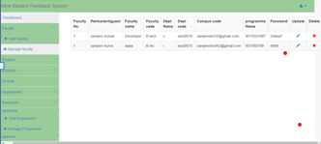
In this manage module admin has privilege to modify the records in database like update and delete.

Slide 33
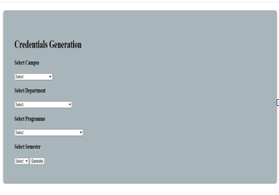
Credential Generation
Inputs: Campus name, Department, Programme and semester.
Output: User id and Password is stored in database.
Use rid contains first word of programme name and first three letters of department name.

Slide 34
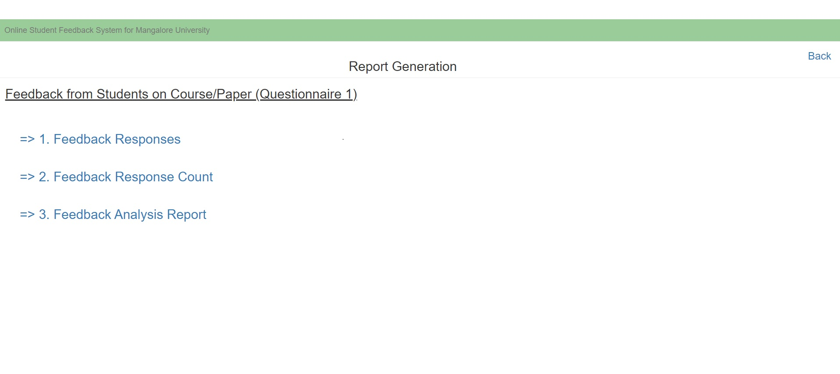
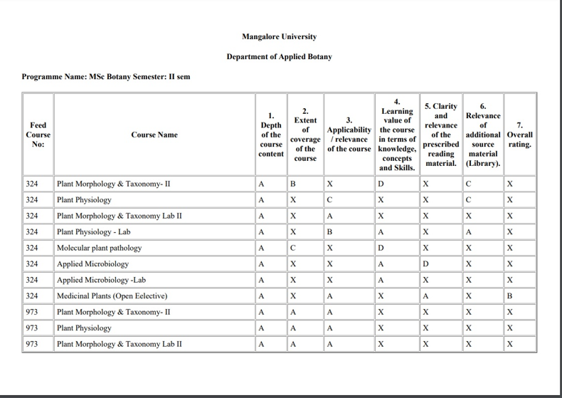
REPORT ANALYSIS

Slide 35
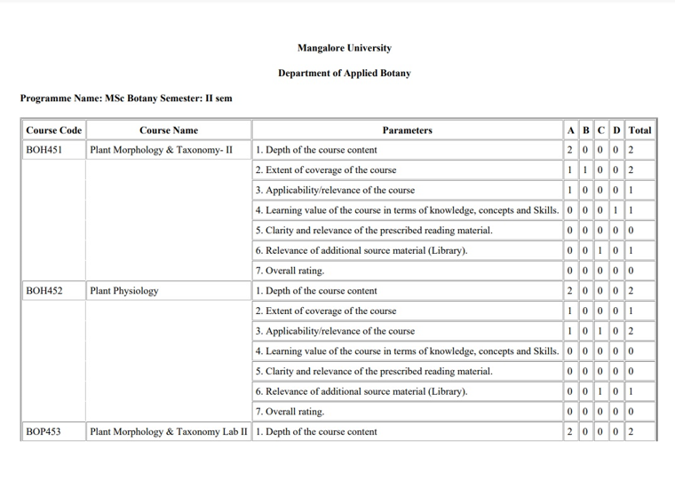
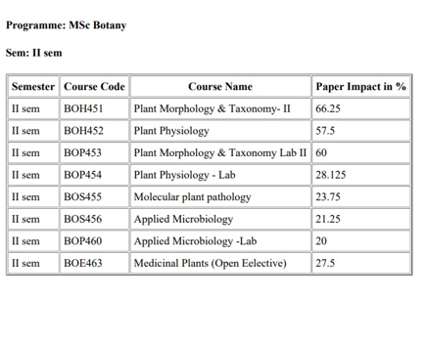

Slide 36
CONCLUSION
The Student Feedback System portal is developed to facilitate easy processing of Feedback in educational institutions. And also, it is possible to freely submit the feedback without any hesitation. So, this portal overcomes all these limitations.

Slide 37
FUTURE WORKS
This project Student Feedback System has been developed in such a manner, that the future requirements of the user are met.
The project is flexible to adapt the changes efficiently without affecting the present system.
In future, there can be a provision to adjust the questions and to new student names and faculty and course through the admin portal.

Slide 38
REFERENCES
https://www.w3schools.com/php/
http://freeproject24.com/php-free-online-feedback-system-with-source-code-freeproject24/
https://www.phptpoint.com/codeigniter-tutorial
https://www.tutorialswebsite.com/how-to-convert-html-to-pdf-in-codeigniter-using-dompdf-library/

Slide 39
THANK YOU

